Slide 1







Keshav Memorial College of Engineering
Inventory
Management
Project Guide: Lt Col Umesh Gogte (Retired)

Slide 2


Slide 3
Welcome
Dr. GVNKV Subbarao

Slide 4
Welcome
Ms Sri Pooja

Slide 5
Keshav Memorial College of Engineering
Inventory
Management
Project Guide: Lt Col Umesh Gogte (Retired)

Slide 6

Team Members:
1. Abhinav Varma 23P81A0579
2. Aditi Jopat 23P81A6903
3. B. Sri Charan 23P81A0574
4. D. Venkat 23P81A6921
5. K. Krithika 23P81A6925
6. M. Sharanya 23P81A6935
7. Md Hafeez Khan 23P81A05B4
8. N. Sai Charan 23P81A6738
9. A. Rushika 23P81A6905
10. S. Akshitha 23P81A6747
11. T. Samiksha 23P81A6753
12. T. A.Deekshit 23P81A6953

Slide 7

HOME PAGE:
Home Page is represented as index.html.
Index.html is the first page to be seen when we open our website
The Home page contains a header with college name , logo and buttons which are linked to other branches.
1.KMIT:
<button onclick="window.location.href='https://www.kmit.in/'">KMIT</button>
2.NGIT:
<button onclick="window.location.href='https://ngit.ac.in/'">NGIT</button>
3.KMEC:
<button onclick="window.location.href='https://kmec.in/'">KMEC</button>
But how are they linked to other websites? Let’s find out!
---T. Abhay Deekshith

Slide 8
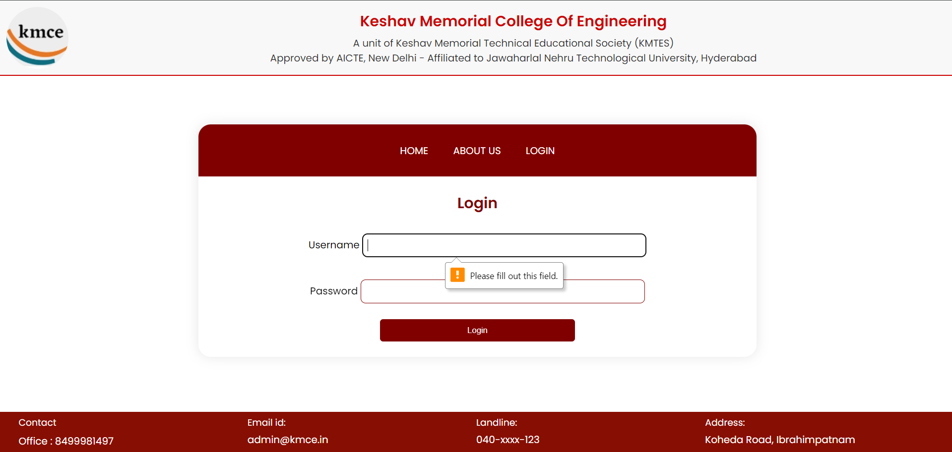
<p><label for="username">username</label> <input type="text" name="username" id="username" required /></p>
<p><label for="password">password</label> <input type="text" name="password" id="password" required /></p>
Required Attribute
(used in login page)
As we click on the login button on the nav bar in Home page then it takes to the login page.
As we can see in login page if we login without filling the required information it shows a block called (please fill out this field). It is done using a special attribute called required
---T. Abhay Deekshith

Slide 9
CSS FOR NAVBAR:
.navbar {
background-color: maroon;
color: white;
}
.navbar a {
color: white;
}
.navbar a:hover {
color: lightgray;
}
---T. Abhay Deekshith

Slide 10

HTML FOR BODY:
CSS FOR BODY:
<div class="container mx-auto p-5">
<div class="container mx-auto p-5">
<h2 class="text-3xl font-semibold main-heading mb-4 about-kmce">About KMCE</h2>
<p class="text-base text-gray-700“>KESHAV-----------</p>
<p class="text-base text-gray-700 mb-4">KMCE has------------</p>
<p class="text-base text-gray-700 mb-4">KMCE is co----------</p>
</div>
.about-kmce {
color: #cc0000;
}
.text-base {
margin-bottom:1rem;
}
---T. Abhay Deekshith

Slide 11

About Us:
About us page is represented as about.html.
When we click on about us, it is navigated from home page to about us page.
About us page consists of courses offered by the college, a navbar and a side navbar.
The page includes a fixed header with the college logo and information, followed by a navigation bar for easy access to various sections
---Abhinav Varma

Slide 12


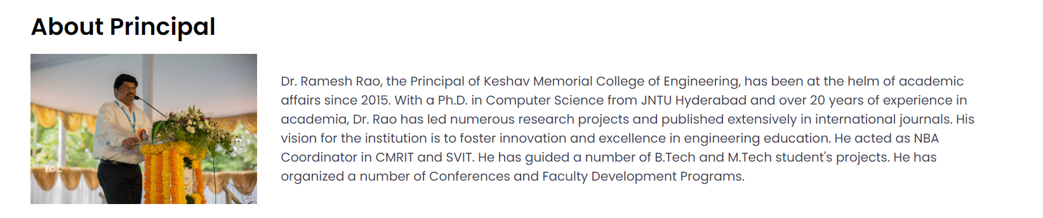

href="#director": When this link is clicked, the browser navigates to the element with the id="director".
Side Navbar:
CSS Code:
.vertical-nav {
background-color: #333;
width: 200px;
height: 100vh;
position: fixed;
top: 100px;
left: 0;
overflow-x: hidden;
padding-top: 20px;
}
href="#principal": When this link is clicked, the browser navigates to the element with the id="principal".
href="#founder": When this link is clicked, the browser navigates to the element with the id="founder".
---Abhinav Varma

Slide 13
CSS FOR HEADER:
CSS FOR FOOTER:
.footer {
display: flex;
justify-content: space-between;
align-items: flex-start;
padding: 20px 30px;
color: #ffffff;
background-color: #870E03;
font-family: 'Poppins', sans-serif;
flex-wrap: wrap;
z-index: 1000;
}
.footer__section {
flex: 1;
margin-bottom: 20px;
}
.header-container {
display: flex;
justify-content: space-between;
align-items: center;
padding: 20px;
background-color: #f8f8f8;
border-bottom: 2px solid #cc0000;
}
In the footer we have the contact details, email id, landline and the address of the college
This header and footer is common for a webpages!
---Abhinav Varma

Slide 14
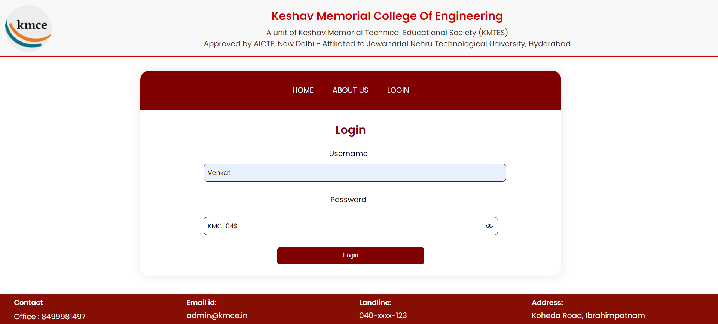
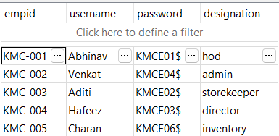
#!C:\Users\user\AppData\Local\Programs\Python\Python37\python.exe hashbang line specifies Python interpreter path.
import os
import cgi Imports os, cgi, and cgitb modules.
import cgitb
cgitb.enable Enables cgitb for user-friendly error messages.
print("Content-type: text/html\n\n"): Prints HTML header and centered "LOGIN PAGE" heading.
print("<html><body style='text-align:center;’>”)
print("<h1 style='color: #800000;'>LOGIN PAGE</h1form = cgi.FieldStorage(): Creates form object to parse CGI form data
.db_name = "venkat21.db": Defines db_name variable for SQLite database.
if os.environ['REQUEST_METHOD'].upper() == 'POST’: Checks if the request method is POST.
if form.getvalue("username"): If username and password are submitted via form:
name = form.getvalue("username”)
if form.getvalue("password"): Retrieves username and password values.
pwd = form.getvalue("password")
def connect_to_db(db_name): Defines a function connect_to_db(db_name) to connect to SQLite database.
try: defining a try block used for exceptional handlings
con = sqlite3.connect(db_name) if the connection is successful,it returns the connection object(con)
return con
except sqlite3.if an error occurs during the connection attempt,it
Error as error: catches the ‘sqlite.Error’ exception,prints an error
print("<p>Error while connecting to SQLite: " + str(error) + "</p>")
return None returns None
Login Page:
---Venkat Madhu Mohan

Slide 15
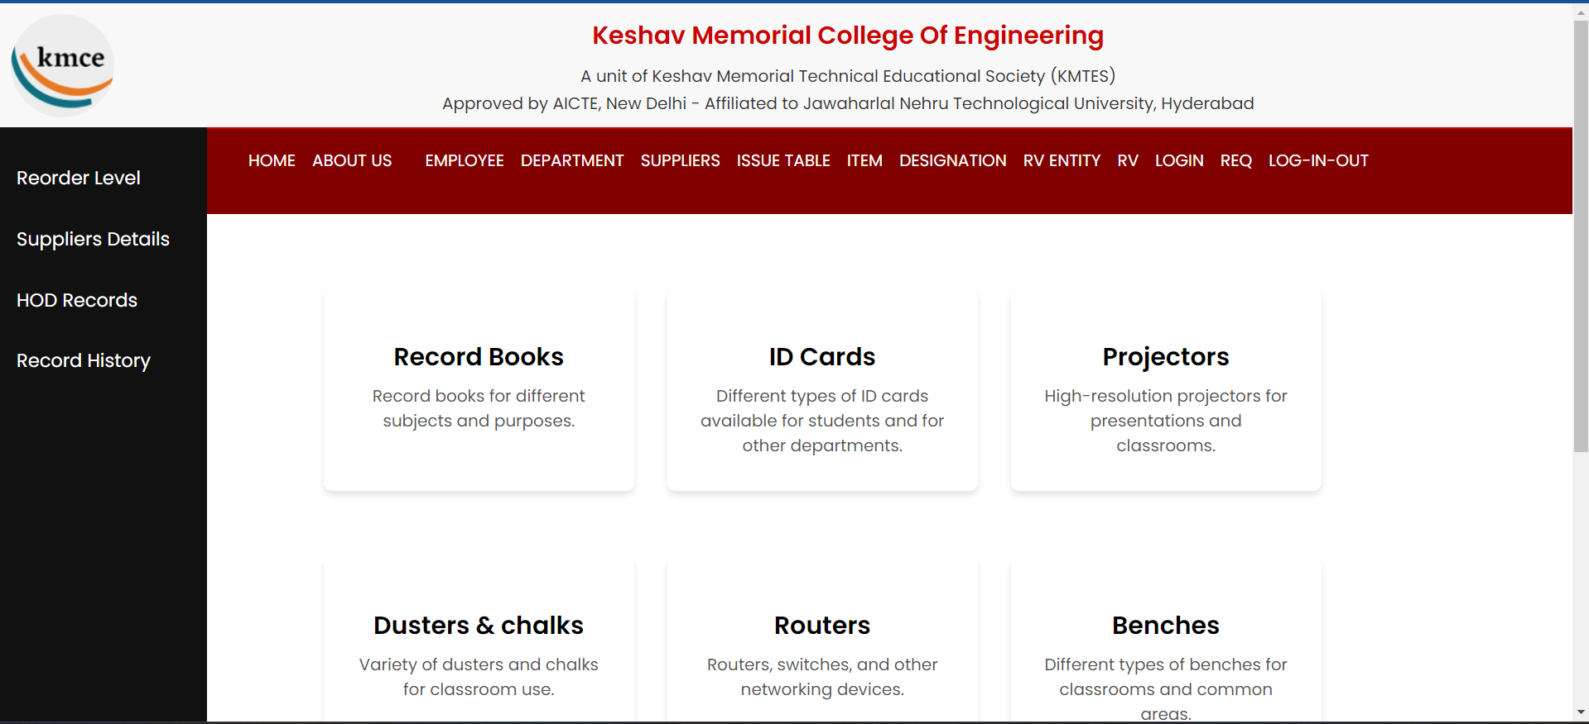
Inventory Page:
if con: Check if the database connection is successful
try: Start a try block to handle potential exceptions
cur = con.cursor() Create a cursor object for executing SQL queries
sql_select = "SELECT designation FROM signup WHERE username = ? AND password = ?“
SQL query to select designation
cur.execute(sql_select, (name, pwd))
Execute the SQL query with username and password Arguments
rec = cur.fetchone() Fetch the first row of the result set
if rec: Check if any record is fetched
designation = rec[0] Extract the designation from the fetched record
if designation == 'hod': Redirect based on designation
print('<meta http-equiv="refresh" content="0;url=hod.html" />')
elif designation == 'admin':
print('<meta http-equiv="refresh" content="0;url=inventory.html" />')
elif designation == 'storekeeper':
print('<meta http-equiv="refresh" content="0;url=store.html" />')
elif designation == 'director':
print('<meta http-equiv="refresh" content="0;url=director.html" />')
elif designation == 'inventory':
print('<meta http-equiv="refresh" content="0;url=indeventoryman.html" />')
else: # Handle unrecognized designation
print("<script>alert('Designation not recognized.'); window.location.href = 'login_form.html';</script>")
else: Handle login failure
print("<script>alert('Login failed. Please try again.'); window.location.href = 'login_form.html';</script>")
except sqlite3.Error as error: Catch SQLite errors
print("<p>Error while executing SQL query: " + str(error) + "</p>")
finally: # Ensure cleanup even if an exception occurs
con.close() Close the database connection
else: # Handle database connection failure
print("<p>Failed to connect to the database</p>")
print("</body></html>") # Close the HTML document
---Venkat Madhu Mohan

Slide 16
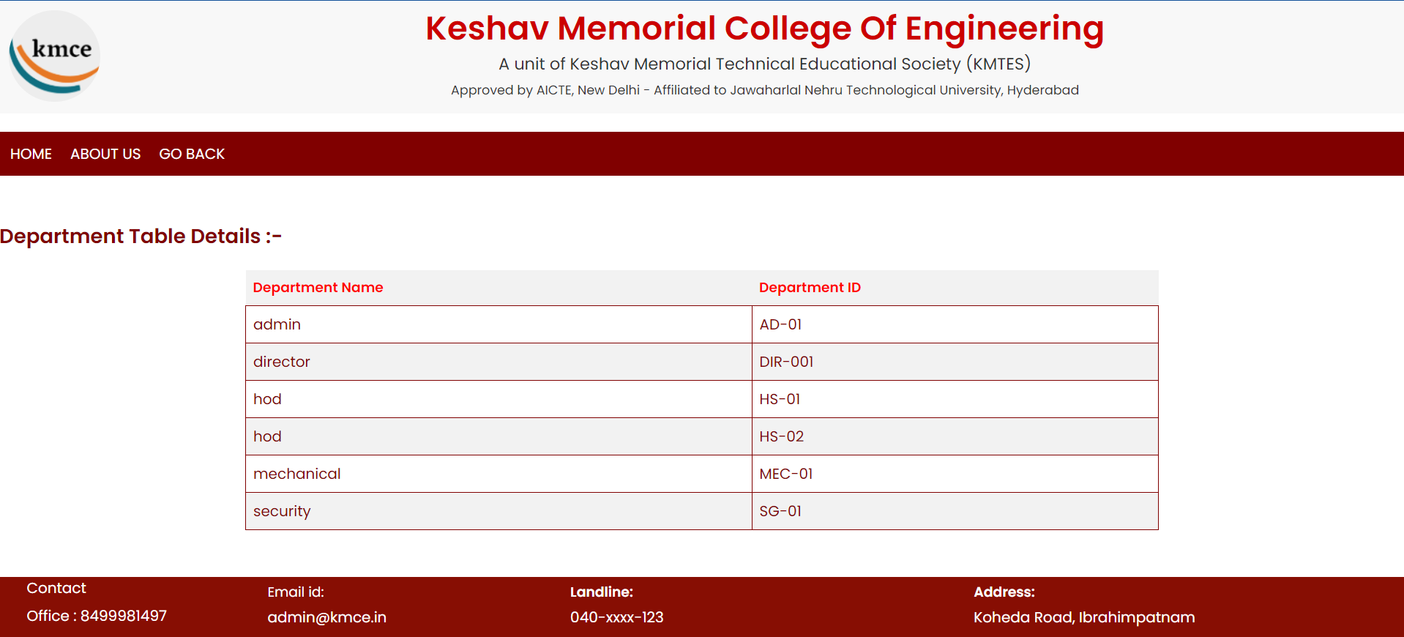
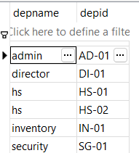
Display Department
cgitb.enable() Enables detailed error messages for cgi scripts
form = cgi.FieldStorage() parses the cgi form data sent and stores it in the ‘form’ object
db_name = “project.db“Specifies the name of the SQLite database file to connect
conn = sqlite3.connect(db_name) Establishes a connection to the SQLite database specified by db_name.
cursor = conn.cursor() Creates a cursor object associated with the database connection, which is used to execute SQL queries
if "action" in form and form["action"].value == "Display": Checks if the form contains a field named "action" and its value is "Display".
cursor.execute("SELECT * FROM department") Executes an SQL query to select all records from the "department" table
employees = cursor.fetchall() Fetches all rows returned by the SQL query and stores them in the employees object..
if "employees" in locals(): Checks if the variable employees is defined in the local namespace.
for employee in employees: Iterates over each employee in the employees list.
print("<tr>") Prints the start of a table row (<tr> tag).
for field in employee:Iterates over each field (column) in the current employee's data.
print("<td style='word-wrap: break-word; border: 1px solid #800000;'>{}</td>".format(field)) Add border to each cell
print("</tr>") Prints the end of the table row (</tr> tag).
else:
print("<tr><td colspan='14'>No department details found.</td></tr>")
print("</table>") Prints a table row with a single cell spanning 14 columns, indicating no department details found.
print("</div>") Closes the HTML table, divs, and their containers.
print("</div>")
---Venkat Madhu Mohan

Slide 17
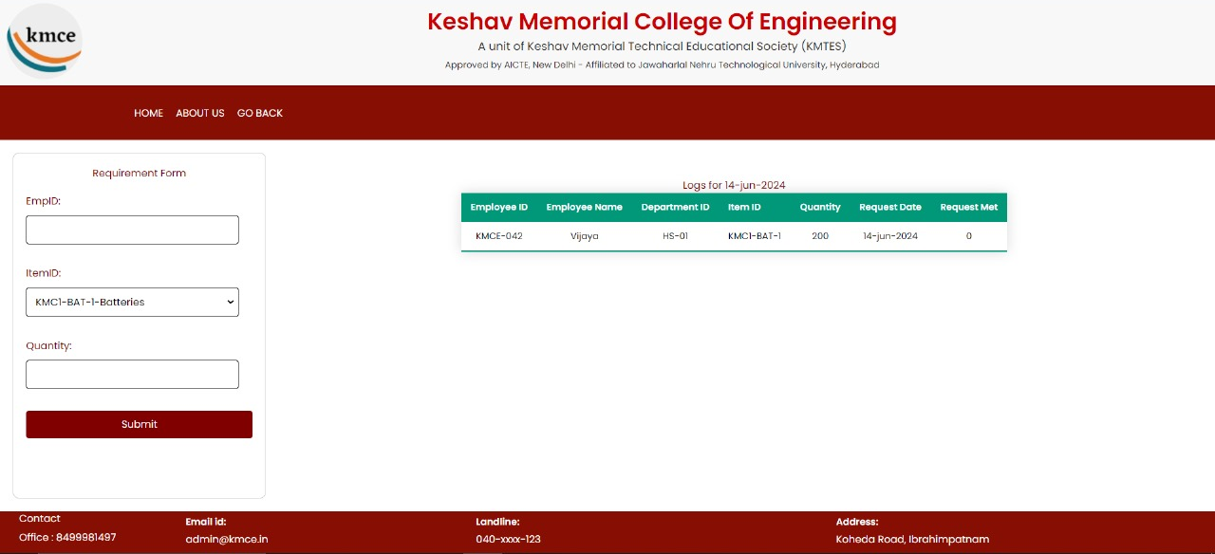
Login as HOD
for item in items:
print(f"<option value='{item[0]}'>{item[0]}-{item[1]}</option>")
print("""
</select><br><br>
<label for="quantity">Quantity:</label>
<input type="text" id="quantity" name="quantity" required><br><br>
<button type="submit">Submit</button>
</form>
</div>
<div class="table-container">
""")
cursor.execute("SELECT itemid, itemname FROM itemtable")
items = cursor.fetchall()
---Md Hafeez Khan

Slide 18
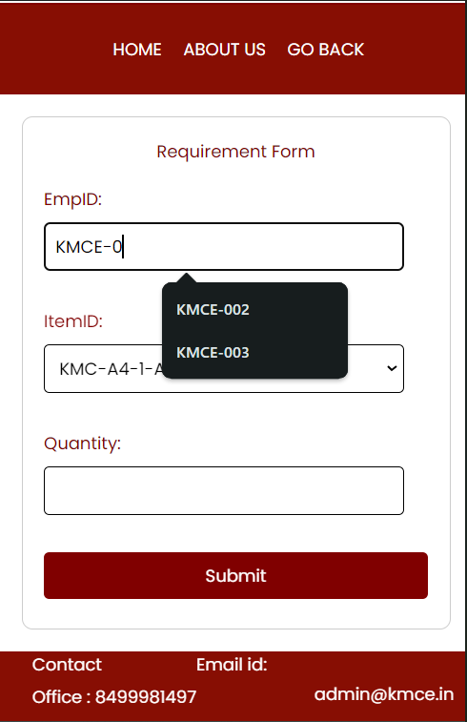
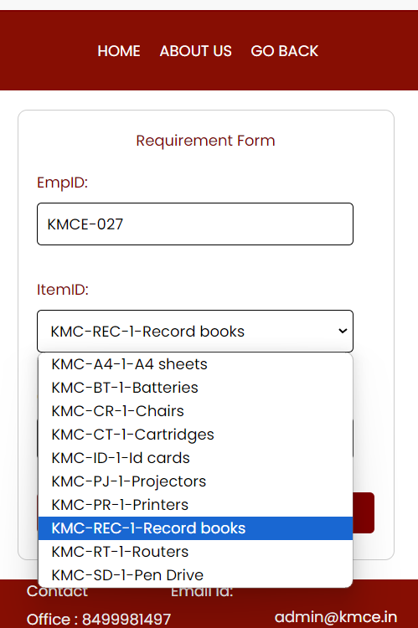
# Populate the dropdown with items
for item in items:
print(f"<option value='{item[0]}'>{item[0]}-{item[1]}</option>")
---Md Hafeez Khan

Slide 19
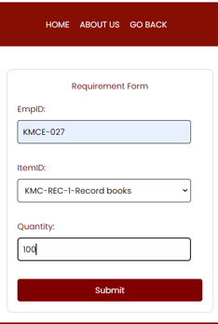
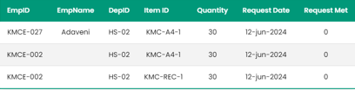
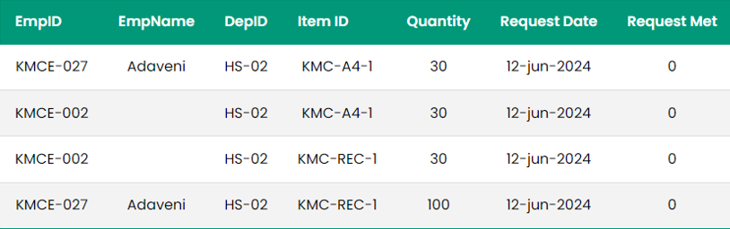
cursor.execute("INSERT INTO requirement (empid, itemid, quantity, reqdate, reqmet) VALUES (?, ?, ?, ?, ?)", (empid, itemid, quantity, reqdate, reqmet))
conn.commit()
print("<p style='text-align: center; color: green;'>Requirement sent successfully!</p>")
---Md Hafeez Khan

Slide 20
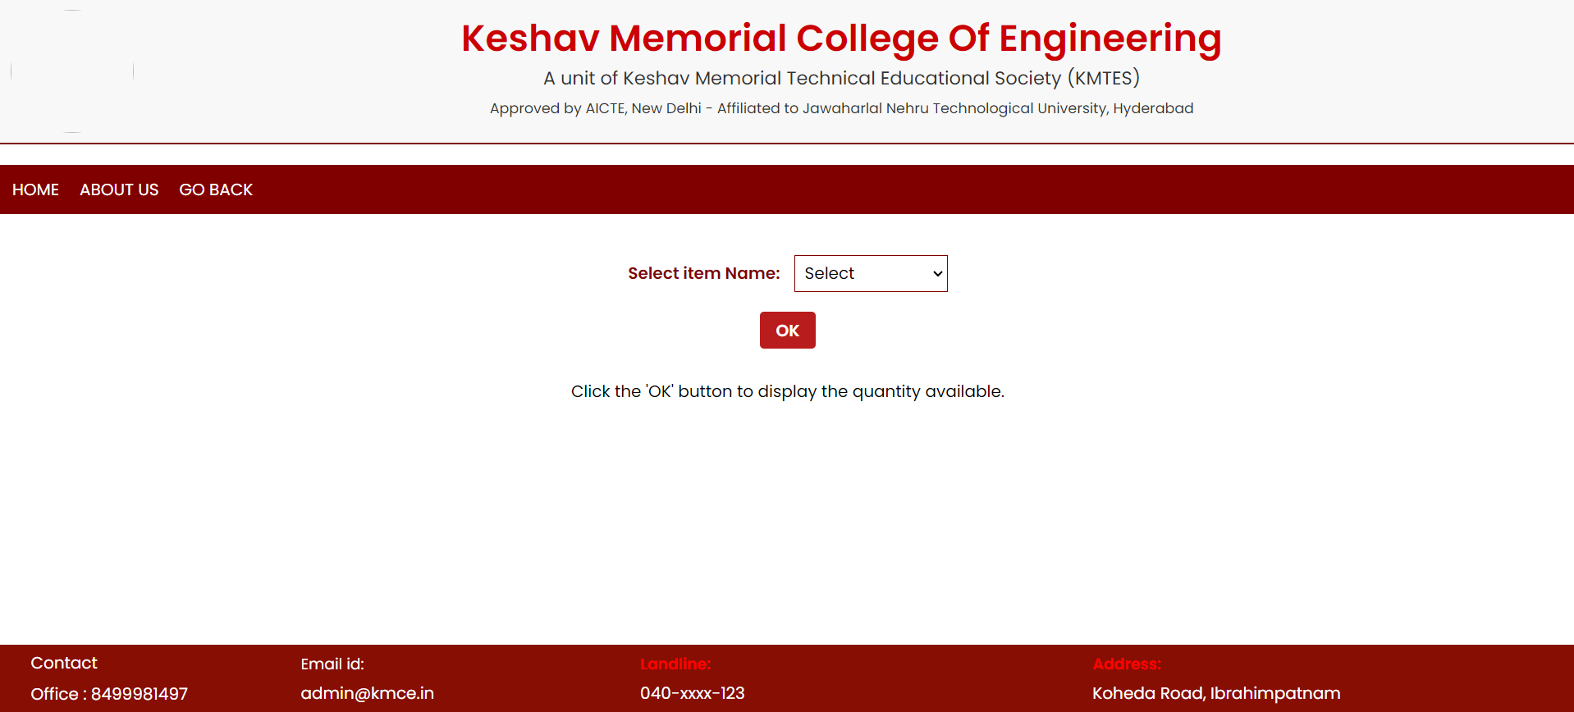
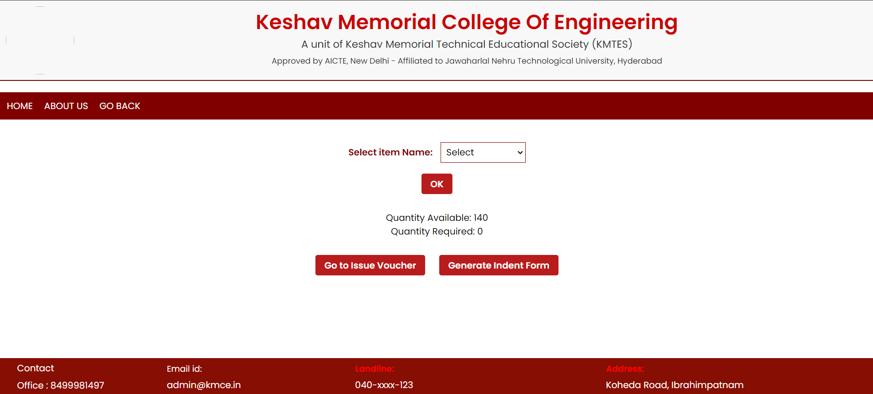
Indent Form
Checking the quantity left before indenting:
Query to find the sum of quantity of item in ivtable:
SELECT SUM(issuequantity) FROM ivtable WHERE itemid=itemid
“Quantity left= quantitybought - sum of issue quantity”
It is redirected to:
Issue Voucher
Indent Form
---Sai Charan

Slide 21
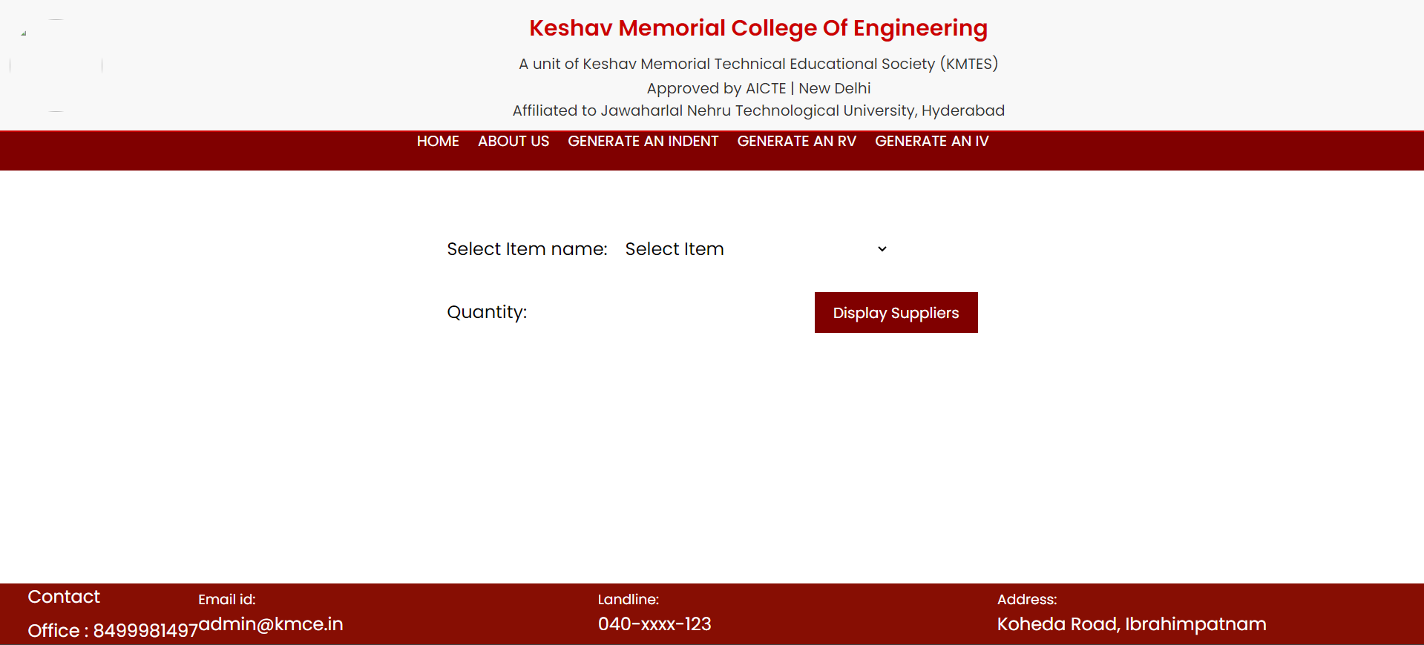
Submitting the Indent Form details
Generating a new indent number:
def generate_new_indent_number():
cursor.execute("SELECT indentno FROM indenttable
ORDER BY indentno DESC LIMIT 1")
last_in_number = cursor.fetchone()
if last_in_number:
last_in_number = last_in_number[0]
last_digits = int(last_in_number.split("-")[1])
new_digits = last_digits + 1
new_in_number = "IN-{0:03d}-2024".format(new_digits)
else:
new_in_number = "IN-001-2024"
return new_in_number
Inserting the details into indent form into indent table:
“INSERT INTO indenttable (indentno, itemid, supid, quantity, approval) VALUES (?, ?, ?, ?, ?)",
(new_indent_number, itemid, supplier, quantity, 0)
Click submit-------->
---Sai Charan

Slide 22
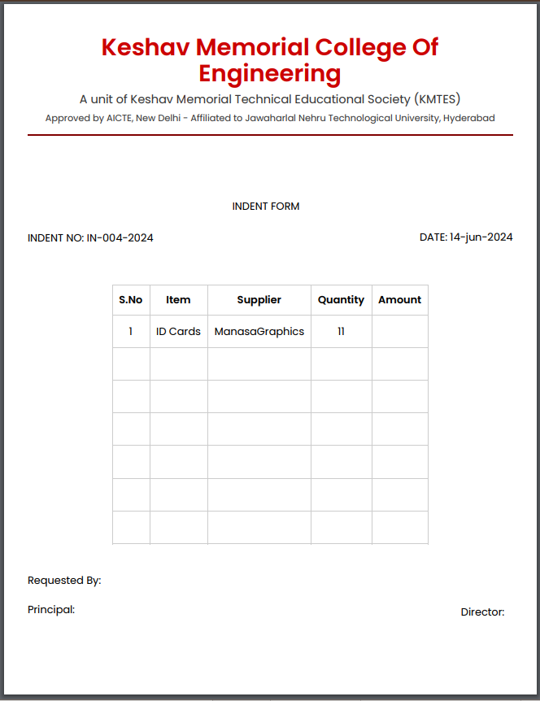
Displaying the Indent Form
Steps:
Fetch details from indent table:
def get_largest_indent_number(cursor):
cursor.execute("SELECT indentno FROM indenttable")
indent_numbers = cursor.fetchall()
largest_indent = max(indent_numbers, key=lambda x: int(re.search(r'IN-(\d+)-2024', x[0]).group(1)))
return largest_indent[0]
# Fetch the largest indent number
largest_indent_number = get_largest_indent_number(cursor)
# Fetch the details of the indent with the largest indent number
cursor.execute("SELECT * FROM indenttable WHERE indentno=?", (largest_indent_number,))
indent_data = cursor.fetchall()
Print the details of the item in INDENT FORM
---Sai Charan

Slide 23
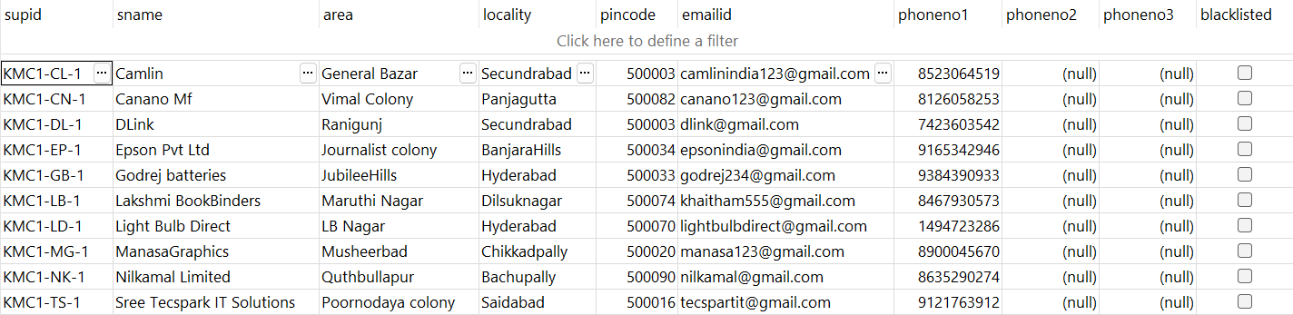
Normalization:
What is Normalization?
Normalization is a systematic approach to organizing data in a database to reduce redundancy and improve data integrity. The main objectives of normalization are to eliminate redundant data and to ensure data dependencies make sense.
1NF:
Definition: A table is in 1NF if it contains only atomic values, and each column contains values of a single type.
The table should have a primary key.
There should not be any repeating groups in one entity
3NF
Definition: A table is in 3NF if it is in 2NF, and all the attributes are functionally dependent only on the primary key.
It must be in 2NF.
There must be no transitive dependency, meaning not depend on other non- key attributes.
Why is it important to normalize the table:
To minimize the redundancy – It is impossible to bring the redundancy to zero but using normalization we can minimize the redundancy.
To avoid insert, delete, update anomalies we use normalization.
2NF:
Definition: A table is in 2NF if it is already in 1NF , and all non-key attributes are fully functionally dependent on the primary key.
It must be in 1NF.
There should be no partial dependency, meaning no non- key attribute should depend on part of a composite primary key.
--- S. Akshitha

Slide 24
Search:
conn = sqlite3.connect(db_name)
cursor = conn.cursor()
cursor.execute("SELECT * FROM suppliers WHERE Sname LIKE ?", ('%' + search_query + '%',))
suppliers = cursor.fetchall()
Sort:
<form method='post' action=''>
<label for='sort_field'>Select Field to Sort By:</label>
<select id='sort_field' name='sort_field'>
<option value='supid'>Supplier ID</option>
<option value='sname'>Supplier Name</option> #All the fields are given as options similarly
</select><br></br>
<button type='submit' name='action' value='Sort'>Sort</button>
</form>
valid_sort_fields = ['supid', 'sname', 'address', 'emailid', 'phoneno1', 'phoneno2', 'phoneno3', 'blacklisted']
if sort_field not in valid_sort_fields:
sort_field = 'supid' # Default sort field
query = f"""
SELECT supid, sname, area || ', ' || locality || ', ' || pincode AS address, emailid, phoneno1, phoneno2, phoneno3, blacklisted from suppliers ORDER BY {sort_field}
""“
cursor.execute(query)
rows = cursor.fetchall()
--- S. Akshitha

Slide 25
Update:
if "supid" in form and "field" in form and "new_value" in form:
supid = form["supid"].value
field = form["field"].value
new_value = form["new_value"].value
update_supplier(supid, field, new_value)
else:
print("<p>Insufficient data provided for update.</p>")
def update_supplier(supid, field, new_value):
try:
cursor.execute("UPDATE suppliers SET {}=? WHERE supid=?".format(field), (new_value, supid))
conn.commit()
print("<p>Supplier details updated successfully.</p>")
except Exception as e:
print("<p>Error updating supplier details: {}</p>".format(str(e)))
--- S. Akshitha

Slide 26
Script for radio:
<script>
function updateFieldInput() {
var fieldSelect = document.getElementById("field");
var newValueLabel = document.getElementById("new_value_label");
var newValueInput = document.getElementById("new_value");
if (fieldSelect.value === "Blacklisted") {
newValueLabel.textContent = "Select New Value:";
newValueInput.innerHTML = `
<input type="radio" id="new_value_yes" name="new_value" value="1">
<label for="new_value_yes">Yes</label>
<input type="radio" id="new_value_no" name="new_value" value="0">
<label for="new_value_no">No</label>
`;
} else {
newValueLabel.textContent = "Enter New Value:";
newValueInput.innerHTML = `<input type='text' id='new_value' name='new_value' style='margin-left: 10px; padding: 5px; border: 1px solid #800000;'>`;
}
}
document.addEventListener("DOMContentLoaded", updateFieldInput);
</script>
--- S. Akshitha

Slide 27
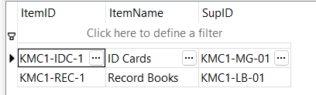
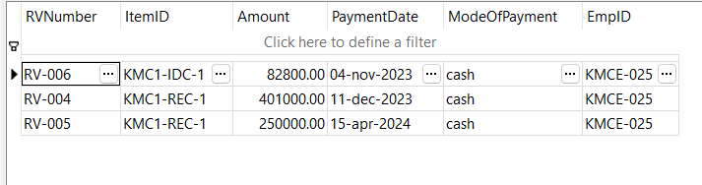
ITEM TABLE
Supplier ID
RV TABLE
Employee ID
Item ID
Both the tables are related to each other with a common field “ITEMID.”
---T. Samiksha Gupta

Slide 28
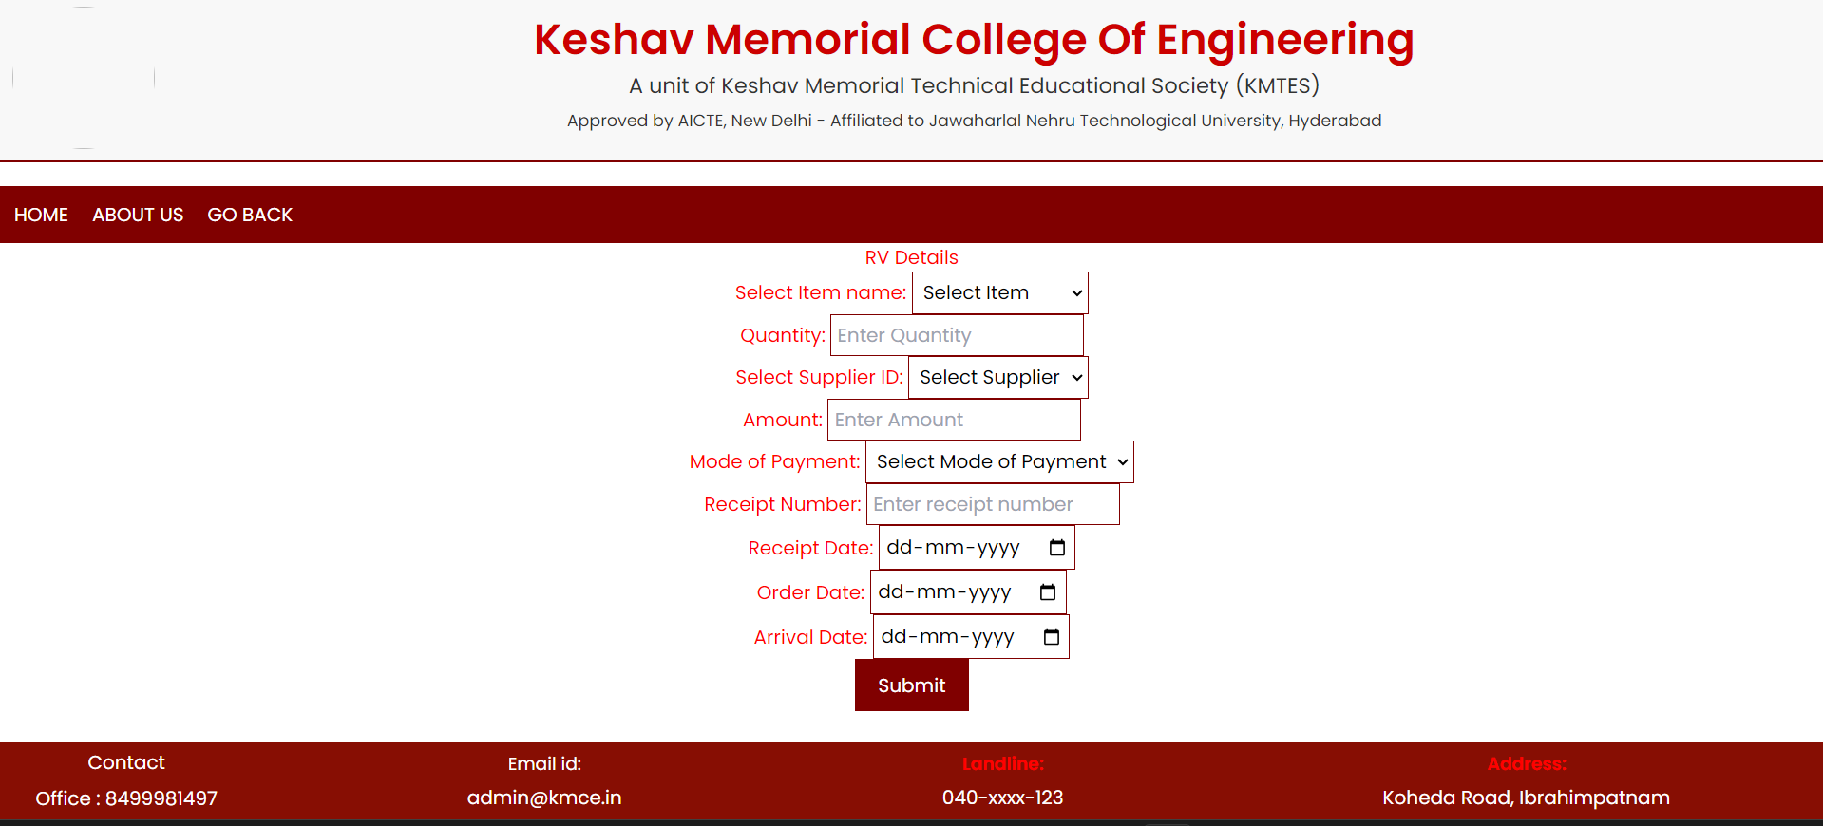
Generation of an RV form:
Data input: User fill out and submit the form on webpage.
---T. Samiksha Gupta

Slide 29


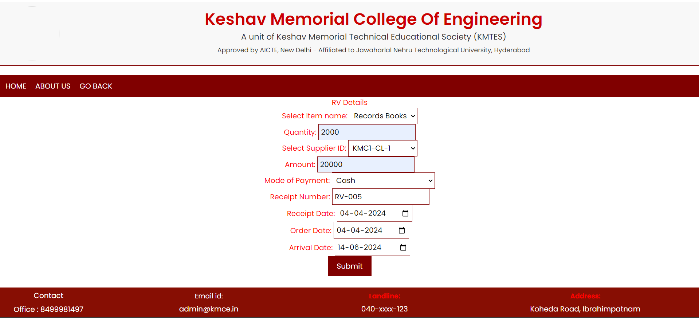
Incrementation of RV Number each time you generate a new RV:
cursor.execute("SELECT rvnumber FROM rvtable ORDER BY rvnumber DESC LIMIT 1")
last_rv_number = cursor.fetchone()
# If there are existing RV numbers
if last_rv_number:
last_rv_number = last_rv_number[0]
# Extract the last three digits from the RV number
last_digits = int(last_rv_number.split("-")[1])
# Increment the last three digits by 1
new_digits = last_digits + 1
# Format the new RV number
new_rv_number = "RV-{0:03d}-2024".format(new_digits)
else:
# If there are no existing RV numbers,
start from RV-001-2024
new_rv_number = "RV-001-2024"
Inserting the data input from user into the rvprint table:
# Insert the form data into the rvprint table
cursor.execute("INSERT INTO rvtable (rvnumber,itemid, quantitybought, supid, amount, modeofpayment, receiptnumber, receiptdate, orderdate, arrivaldate) VALUES (?,?,?,?,?,?,?,?,?,?)",
(new_rv_number,itemname, quantity, supid, amount, mode_of_payment, receipt_num, receipt_Date, order_Date, arrival_Date))
conn.commit()
---T. Samiksha Gupta

Slide 30
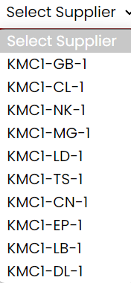
Supplier drop down:
def generate_supplier_dropdown():
cursor.execute("SELECT DISTINCT supid FROM itemtable")
suppliers = cursor.fetchall()
dropdown_html = "<select name='supid' id='supid' style='border: 1px solid #800000; padding: 5px; display: inline-block;'>"
dropdown_html += "<option value='' selected disabled>Select Supplier</option>" # Set default option
for supplier in suppliers:
dropdown_html += "<option value='{}'>{}</option>".format(supplier[0], supplier[0])
dropdown_html += "</select>"
return dropdown_html
---T. Samiksha Gupta

Slide 31
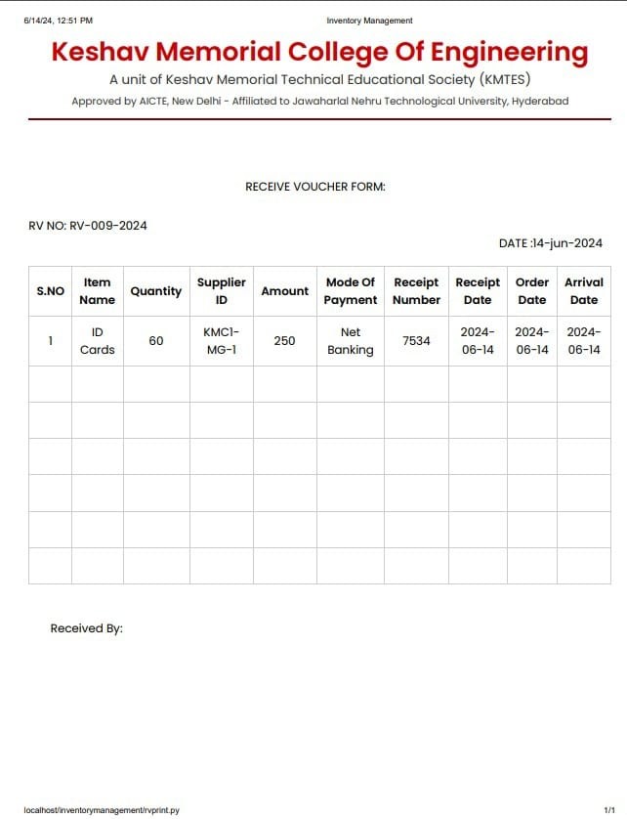
Printing of the RV form:
print("<div style='text-align: center;'>")
print("<table style='margin: 0 auto; border-collapse: collapse;'>")
print("<tr>")
print("<th style='padding: 10px; border: 1px solid #ccc;'>S.NO</th>")
print("<th style='padding: 10px; border: 1px solid #ccc;'>RV Number</th>")
print("<th style='padding: 10px; border: 1px solid #ccc;'>Item ID</th>")
print("<th style='padding: 10px; border: 1px solid #ccc;'>Amount</th>")
print("<th style='padding: 10px; border: 1px solid #ccc;'>Payment Date</th>")
print("<th style='padding: 10px; border: 1px solid #ccc;'>Mode Of Payment</th>")
print("<th style='padding: 10px; border: 1px solid #ccc;'>Quantity</th>")
print("</tr>")
The RV form is then generated by fetching the input from user from the rvprint table.
---T. Samiksha Gupta

Slide 32
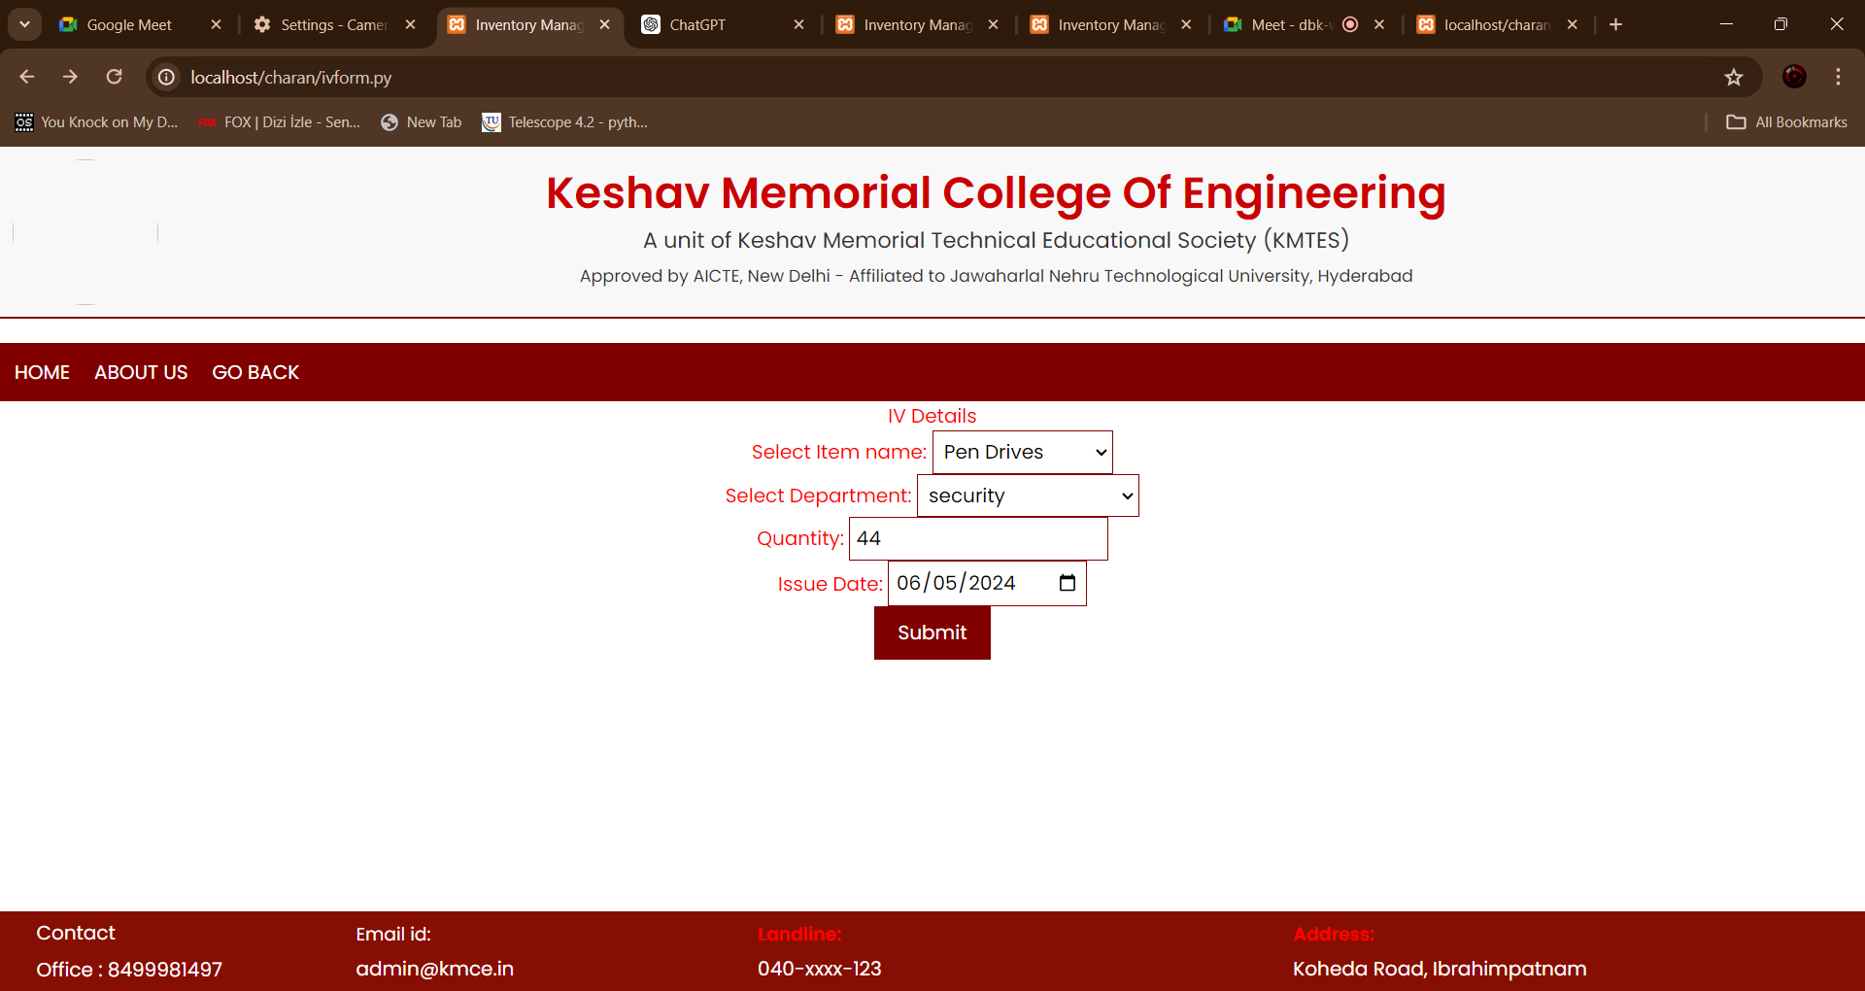
IV FORM
HOW THE DROP DOWN TAKES PLACE:
def generate_item_dropdown():
cursor.execute("SELECT DISTINCT itemname FROM itemtable")
items = cursor.fetchall()
dropdown_html = "<select name='itemname' id='itemname' onchange='displayDepartments()' style='border: 1px solid #800000; padding: 5px; display: inline-block;'>"
dropdown_html += "<option value='' selected disabled>Select Item</option>" # Set default option
for item in items:
dropdown_html += "<option value='{}'>{}</option>".format(item[0], item[0])
dropdown_html += "</select>"
return dropdown_html
---Sri Charan

Slide 33
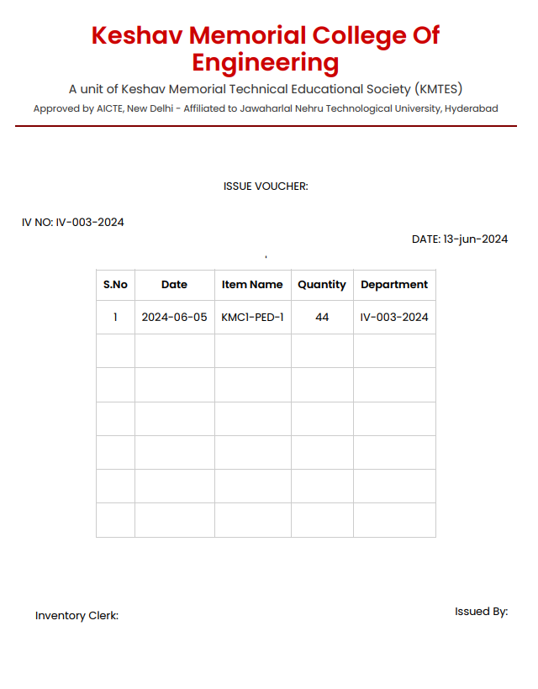
IV Number generation:
cursor.execute("SELECT ivnumber FROM ivtable ORDER BY ivnumber DESC LIMIT 1")
last_iv_number = cursor.fetchone()
if last_iv_number:
last_digits = int(last_iv_number[0].split("-")[1]) + 1
new_iv_number = "IV-{0:03d}-2024".format(last_digits)
else:
new_iv_number = "IV-001-2024"
---Sri Charan

Slide 34
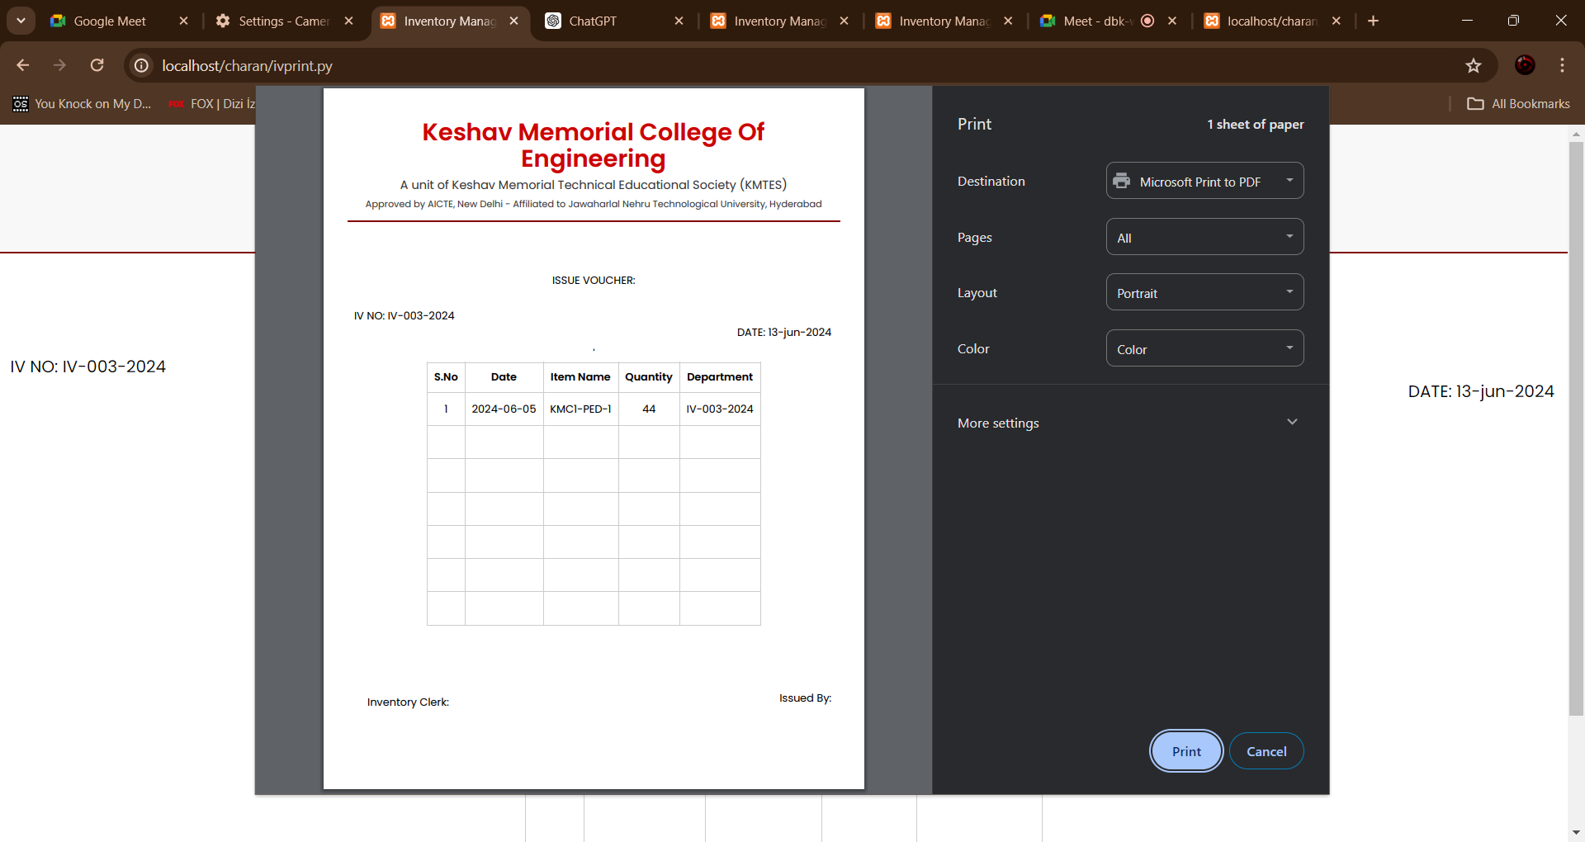
Use of IV
print page:
It will sort the table to find the highest iv number which is latest and prints the corresponding details
---Sri Charan

Slide 35
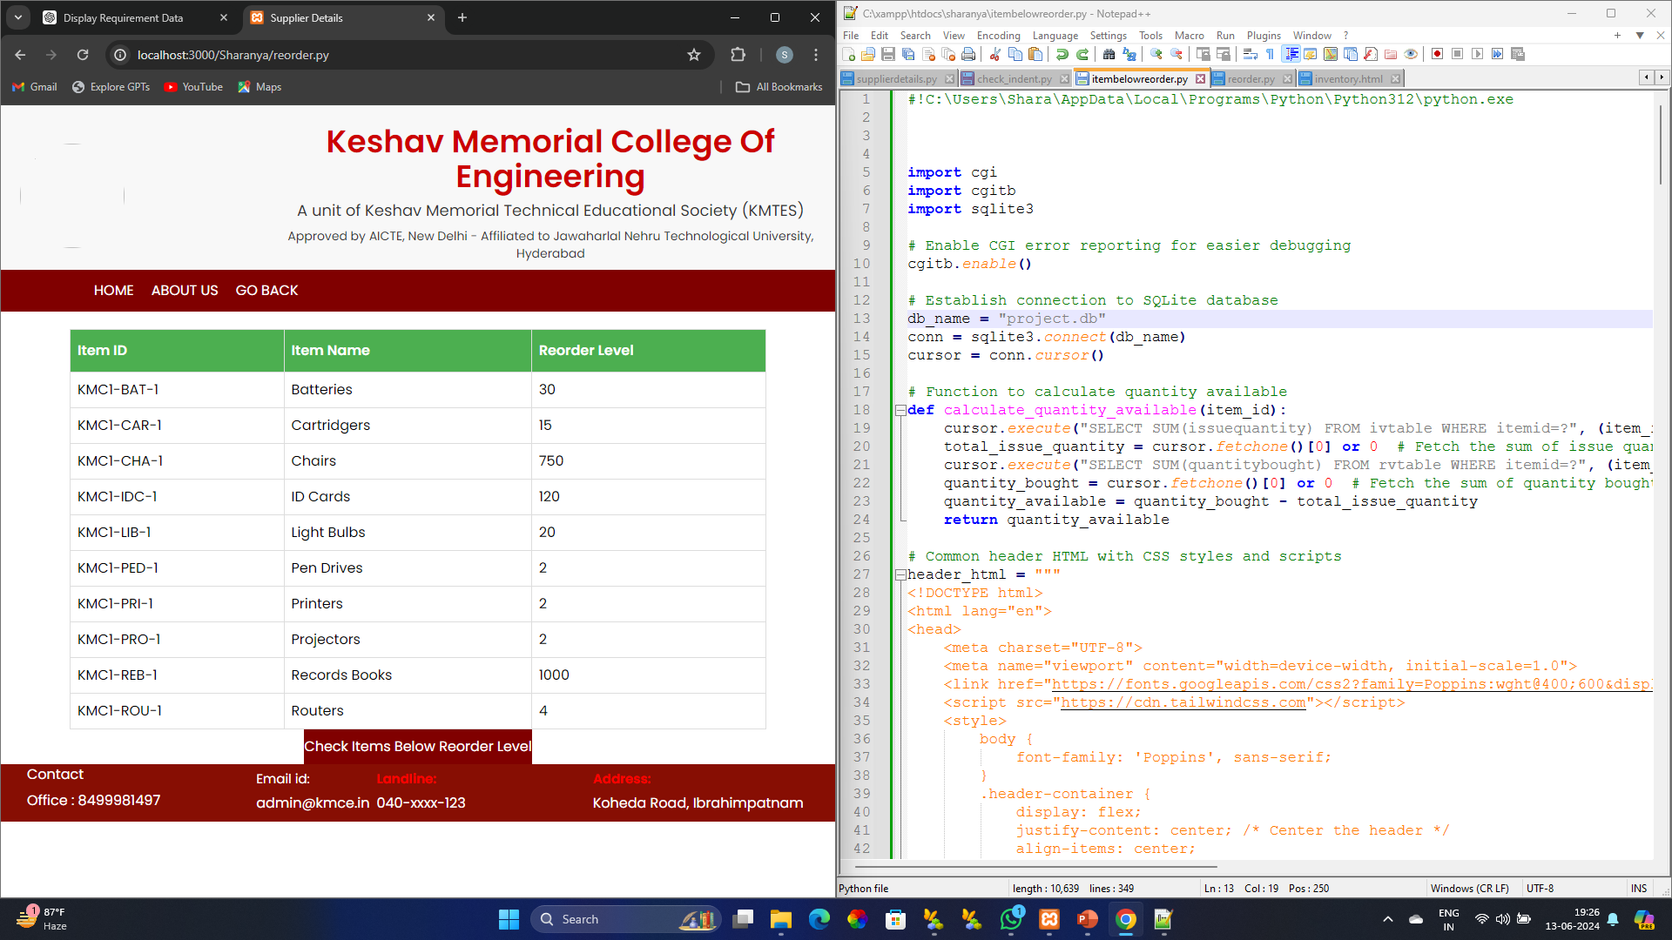
Reorder Level
Code to display reorder level:
def display_item_table(): #a function
cursor.execute("SELECT itemid, reorderlvl, itemname FROM itemtable") #cursor object establishes connection btw database, execute ids a method defined in sqlite3 module which helps to execute a query & SELECT is a clause, which seletcs particular field from particular table
rows = cursor.fetchall() #all the data which matches sql query is fetched by method fetchall() & stored in rows object
if rows: #if rows object isn’t empty
print("<div style='max-width: 800px; margin: auto;padding-top: -20px;'>") # Limiting the width of the table
print("<table>")
print("<tr><th>Item ID</th><th>Item Name</th><th>Reorder Level</th></tr>") #printing table fieldnames using html
for row in rows: #iterating through data stoted in rows
print(f"<tr><td>{row[0]}</td><td>{row[2]}</td><td>{row[1]}</td></tr>") #at 0th index itemid, at 1st index reorderlevel, 2nd index itemname are present
print("</table>")
print("</div>")
else:
print("<p>No items found.</p>")
display_item_table() #function call
---M. Sharanya

Slide 36
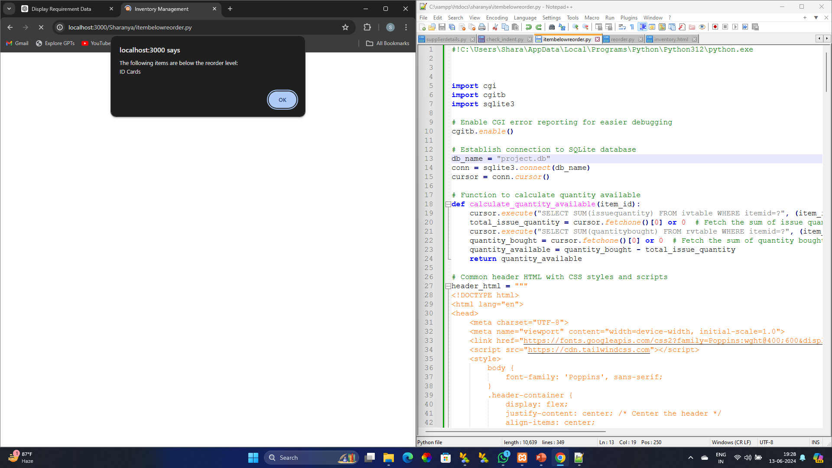
This particular block of code will display an alert message:
This javascript code is integrated in .py file:
function showAlert(itemsBelowReorder) {
if (itemsBelowReorder.length > 0) {
var message = "The following items are below the reorder level:\\n";
for (var i = 0; i < itemsBelowReorder.length; i++) {
message += itemsBelowReorder[i] + "\\n";
}
alert(message);
print("<script>")
print(f"showAlert({str(items_below_reorder_list})) #showAlert() function call inside the script is intended to execute JavaScript code that shows an alert message & list is type casted into string. ‘f’ formats the output
print("</script>")
Code that’ll redirect to check items below reorder level:
print("""
<div class="button-container" style="text-align: center; margin-top: 0px;">
<form method="post" action="itembelowreorder.py">
<button type="submit" class="button" name="check_reorder_button" style="background-color:#800000 ; color: white;height: 40px;">Check Items Below Reorder Level</button>
</form>
</div>
""")
---M. Sharanya

Slide 37
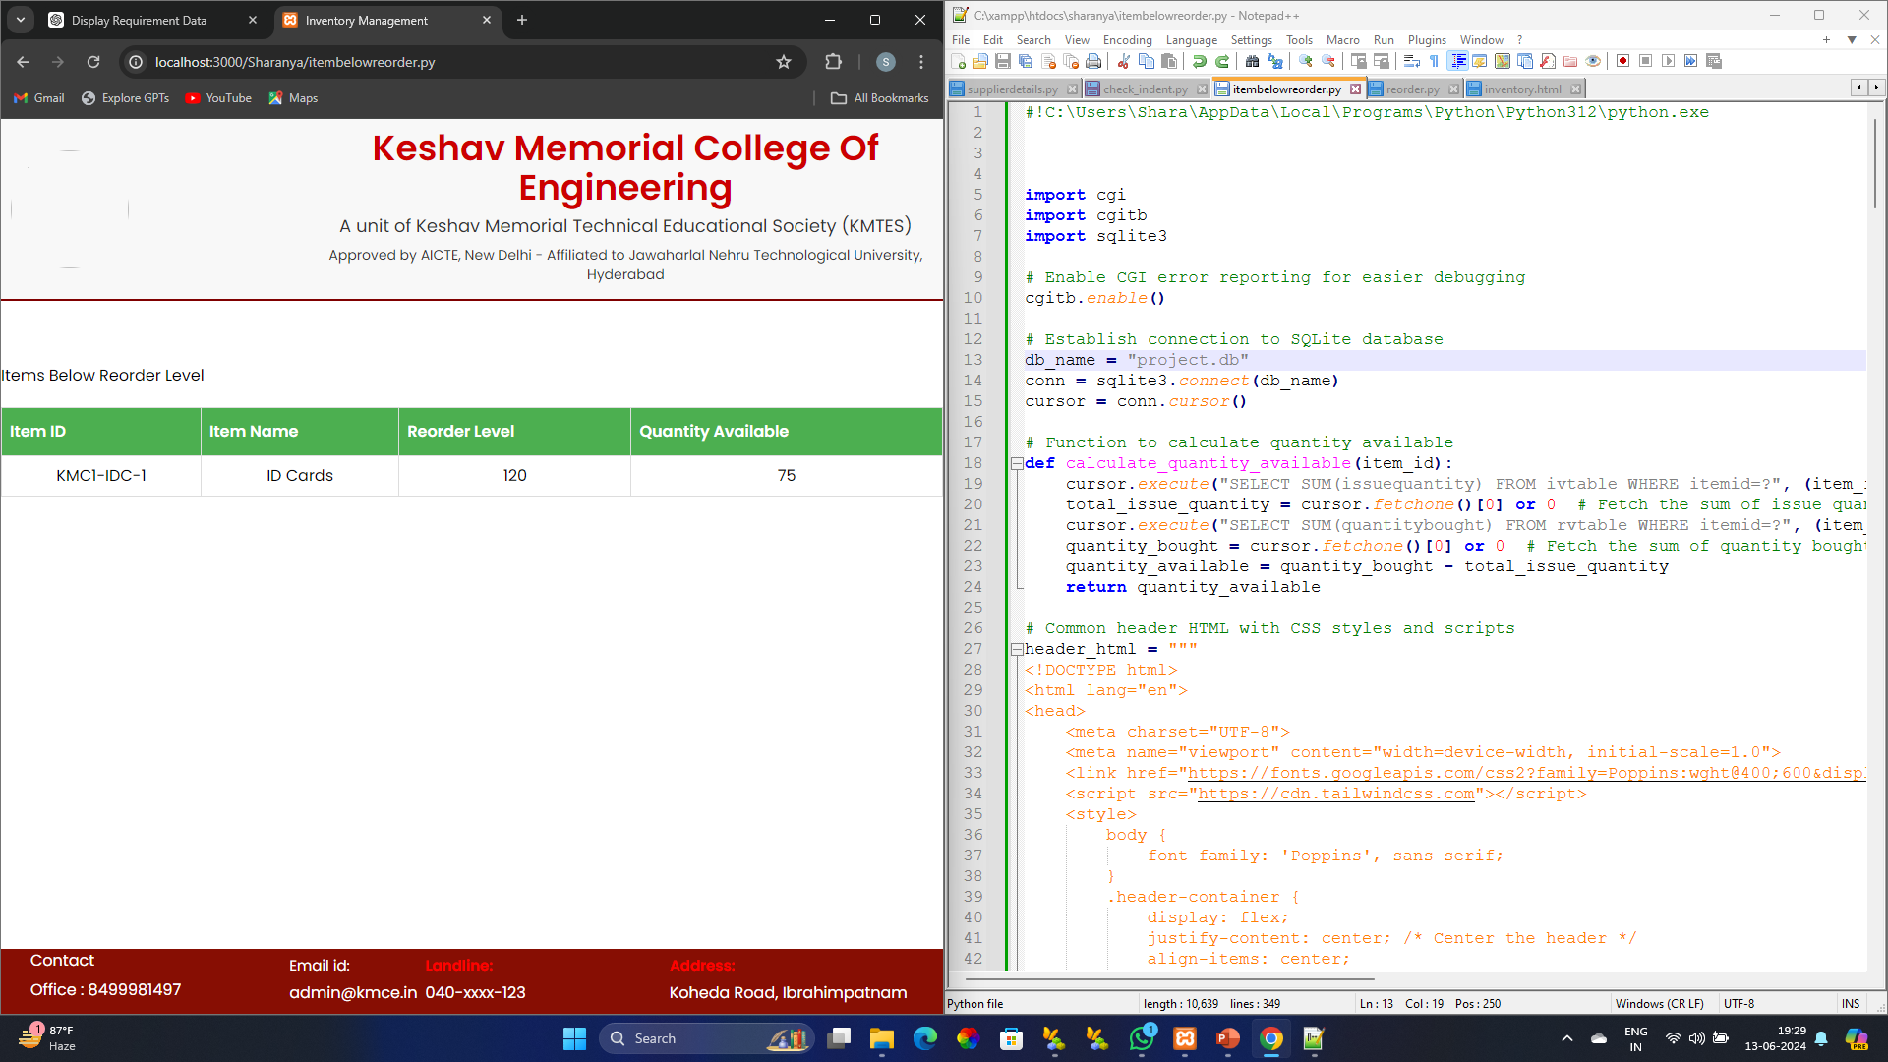
Code after redirecting to the page which gives data about the items below reorder level:
This block of code calculates quantity
left after issuing items:
This block of code will check & display a table of items
below reorder level:
def calculate_quantity_available(item_id):
cursor.execute("SELECT SUM(issuequantity) FROM ivtable WHERE itemid=?", (item_id,))
total_issue_quantity = cursor.fetchone()[0] or 0
cursor.execute("SELECT SUM(quantitybought) FROM rvtable WHERE itemid=?", (item_id,))
quantity_bought = cursor.fetchone()[0] or 0
return quantity_available
This block of code will check & display a table of items below reorder level:
cursor.execute("SELECT itemid, itemname, reorderlvl FROM itemtable")
items = cursor.fetchall()
items_below_reorder_list = []
items_below_reorder = False
for item in items:
item_id, item_name, reorder_level = item
quantity_available = calculate_quantity_available(item_id)
if quantity_available < reorder_level:
items_below_reorder = True
items_below_reorder_list.append(item_name)
print(f"<tr><td>{item_id}</td><td>{item_name}</td><td>{reorder_level}</td><td>{quantity_available}</td></tr>")
if not items_below_reorder:
print("<tr><td colspan='4' style='text-align:center;'>No items below reorder level.</td></tr>")
---M. Sharanya

Slide 38
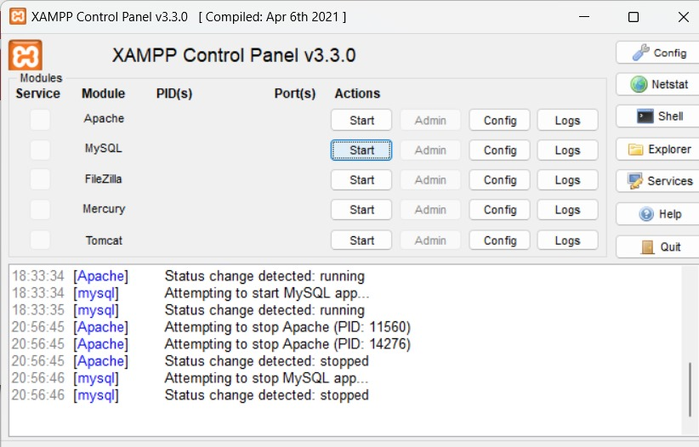
How to operate the xaamp control panel?
What is XAAMP?
XAMPP is a cross platform that incorporates a bundle of frameworks. It can be operated in multiple operating system platforms with ease.
---Krithika

Slide 39
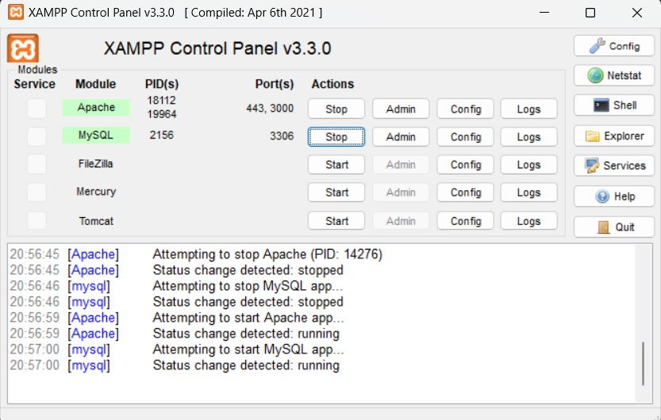
Start Services:
In the XAMPP Control Panel, you can start services like Apache and MYSQL by clicking the “Start” button next to each module.
Verification Installation:
Once Apache and MYSQL are running, you can verify the installation by opening a web browser and typing http://localhost into the address bar. You should see the XAMPP welcome page.
---Krithika

Slide 40
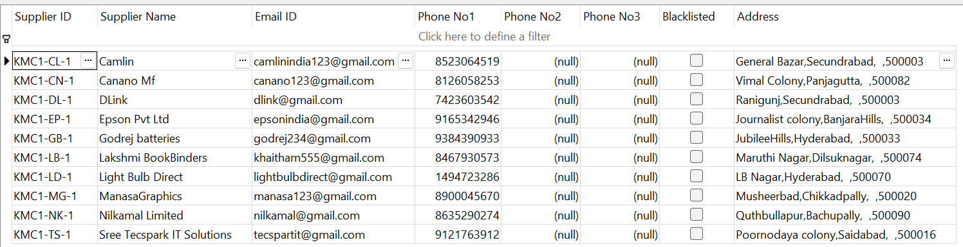
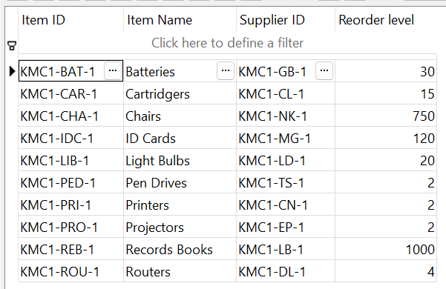
Supplier table
Primary key = Supplier ID
SELECT*FROM suppliers;
This query displays all the fields of the table
Item table
Primary key = Item ID and Supplier ID
Supplier ID
Both the tables are related with the common field which is Supplier ID.
SELECT*FROM itemtable;
This query displays all the fields of the table
---Krithika

Slide 41
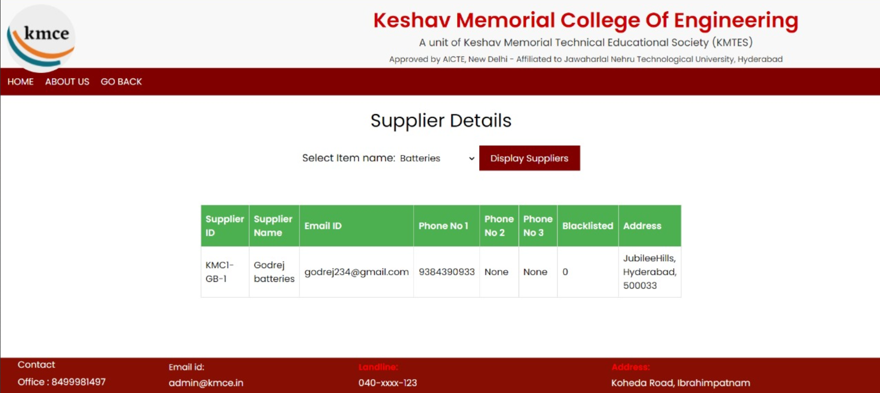
Supplier details
# Function to get suppliers based on item name
def get_suppliers(itemname): #Defining a function , ’ get_suppliers’ as a function name and passing itemname as a parameter
Cursor.execute("SELECT * FROM suppliers WHERE supplierid IN (SELECT supplierid FROM itemtable WHERE itemname=?)", (itemname,)) #Cursor is an object that allows interaction with sqlite database
#execute() method is used to run the sql query.In the subquery, 'SELECT supplierid' retrieves the ‘supplierid' column from the 'itemtable' table, 'FROM itemtable' specifies the table to query, 'WHERE itemname =?' filters rows to only those where 'itemname' matches the provided parameter,'?' is a placeholder for the parameter value, which is substituted with 'itemname’ ,This subquery returns a list of ‘supplierid's that matches the given 'itemname’.In the main query, 'SELECT *' retrieves all columns from the 'suppliers' table, ’FROM suppliers' specifies the table to query, 'WHERE supplierid IN ()' filters rows to only those where ‘supplierid' is in the list returned by the subquery, 'IN' is a SQL operator that checks if a value matches any value in a list or subquery
suppliers=cursor.fetchall() #fetchall()method fetches all the records of the query and stores them in the suppliers object
return suppliers # Returns the list of supplier records fetched from the database
--- A. Rushika

Slide 42
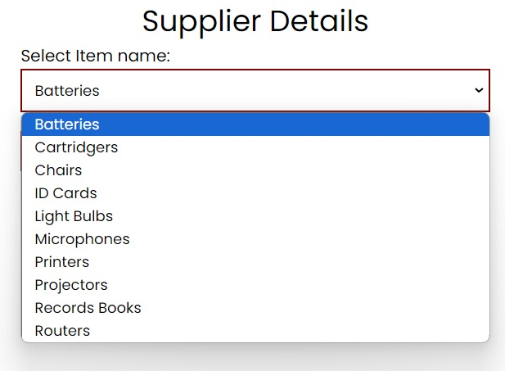
# Generate HTML for dropdown menu
def generate_dropdown():#Defining a function, 'generate_dropdown' is the function name and it takes no parameters.
cursor.execute("SELECT DISTINCT itemname FROM itemtable") # Execute a SQL query to select distinct itemnames from the 'itemtable’
items=cursor.fetchall() # 'cursor.fetchall()' fetches all unique itemnames resulting from the query and stores them in the 'items’ variable.
dropdown_html = "<select name='itemname' id='itemname>”# Initializing an HTML string,in which select element is used to create a dropdown list, ’name’ attribute is used to specify name of dropdown menu,the itemname selected from the dropdown will be sent to the server with the ‘itemname’ as key and id attribute is assigned to a unique itemname to the dropdown menu.
for item in items: # Item object iterates over each item stored in the items variable.
dropdown_html += "<option value='{}'>{}</option>".format(item[0], item[0]) #For each item add an <option> element to the drop down menu, format()method is used to specify values and insert them to the placeholders{},this method inserts the {} with item[0] which stores the first column of the current row which is itemname.
dropdown_html += "</select>“ #Closing the select tag for the dropdown menu
return dropdown_html # Return the complete HTML string for the dropdown menu
--- A. Rushika

Slide 43
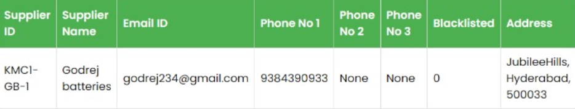
# Get item name from submission
itemname = form.getvalue("itemname") #getvalue() is a method of the form object that retrieves the value.
suppliers = [] #Initializes empty list named suppliers to store the supplier details
if itemname: #If condition checks the itemname before entering the block
suppliers=get_suppliers(itemname) #If item name is provided, this line calls get_suppliers function with itemname as argument and stores the result in suppliers
on the button which is Suppliers.
print("</form>") #Closing tag of the form indicates end of the html form element
print("<div id='supplierTable’>”) # div tag is used to group other elements in the html form where id is the SupplierTable
if suppliers: #If condition checks if the supplier list is not empty
print("<table border='1’>”) #Creating a table element with a border width of 1
print("<tr><th>SupplierID</th><th>Name</th><th>Area</th><th>Locality</th><th>Pincode</th><th>Email</th><th>Phone 1</th><th>Phone 2</th><th>Phone 3</th><th>Blacklisted</th></tr>") #<tr> tag is used to create a new table row in that row <th> tag is used to create table header for every <th> tag a new table header cell gets created with given names.
for supplier in suppliers: #supplier object iterates over the list of suppliers
print("<tr>") #Prints new table row for each supplier
for field in supplier: #field iterates over each record in the supplier object
print("<td>{}</td>".format(field)) #Print the table data with the corresponding field value, the {} placeholder for the field value which is inserted using format() method
print("</tr>") #Prints the closing tag for the table row after all fields for the current supplier have been printed
print("</table>") #Prints the closing tag for entire table.
else: #Whether if condition fails else block get executed
print("<p>No suppliers found for the selected item.</p>") #<p> paragraph tag is used to print a block of text
print("</div>") #Closing the div tag after grouping all the elements in the html
--- A. Rushika

Slide 44
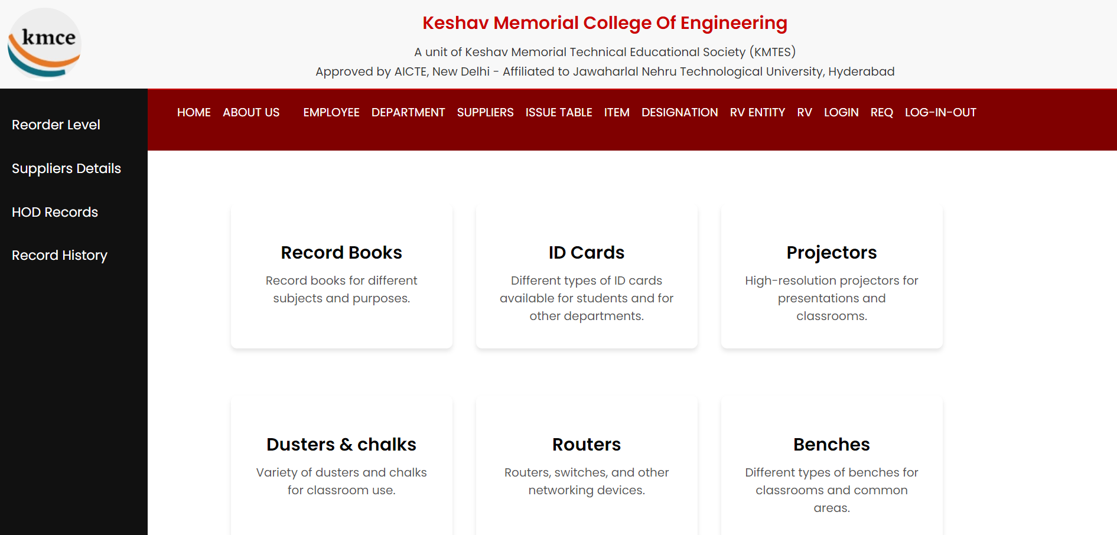
Login as Admin and click on Record History
---Aditi Jopat

Slide 45
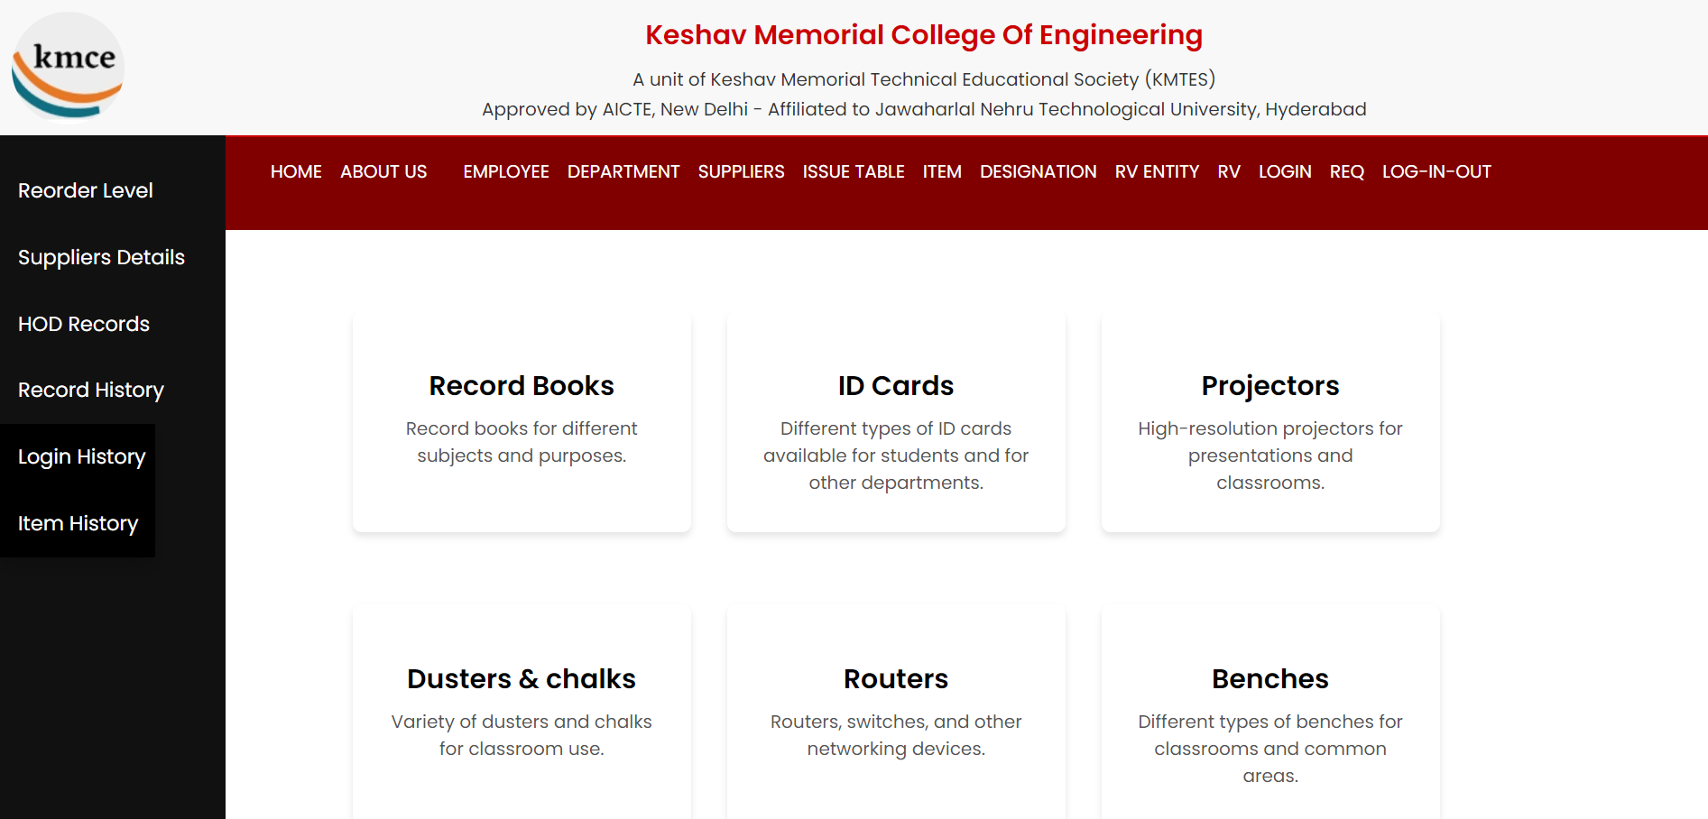
<button class="dropdown-btn">Records
<i class="fa fa-caret-down"></i>
</button>
<div class="dropdown-content">
<a href="login_history.py?action=Display">Login History</a>
<a href="item_history.py?action=Display">Item History</a>
</div>
Under Record history we have Login History
and Item History
---Aditi Jopat

Slide 46
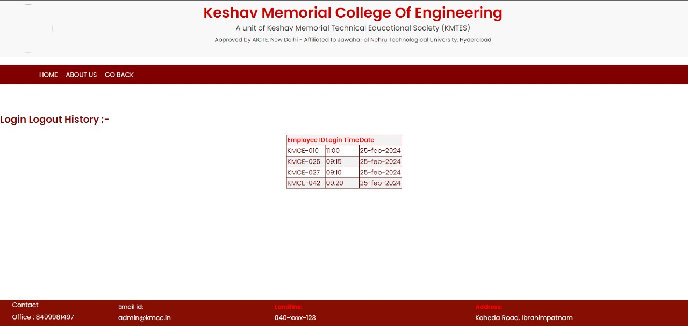
Login History
if "action" in form and form["action"].value == "Display":
cursor.execute("SELECT * FROM loginout")
employees = cursor.fetchall()
---Aditi Jopat

